Slide 1
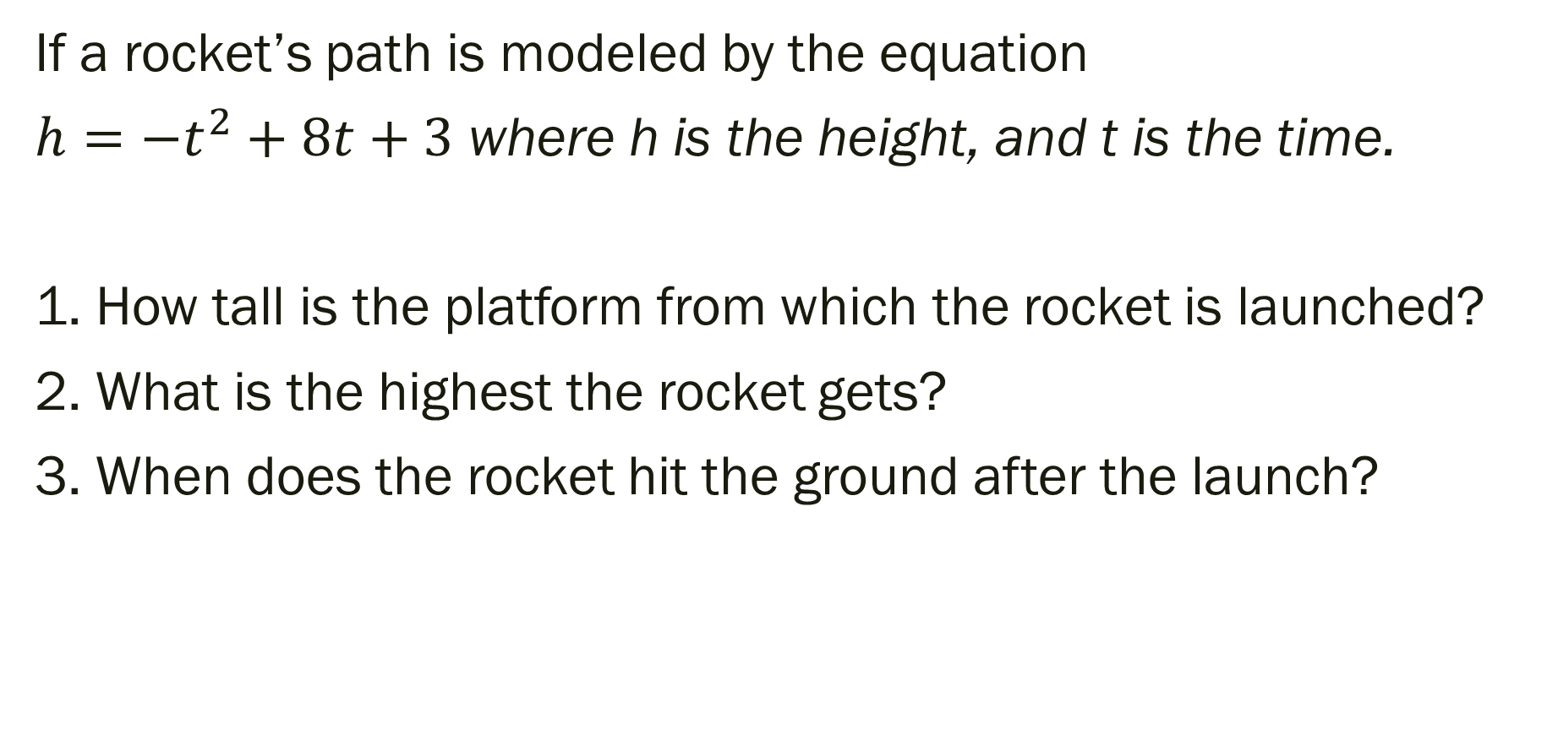
Bell Work:
If a rocket’s path is modeled by the equation
$h={−t}^{2}+8t+3$ where h is the height, and t is the time.
1. How tall is the platform from which the rocket is launched?
2. What is the highest the rocket gets?
3. When does the rocket hit the ground after the launch?

Slide 2
For Next Time
New Material:
Page 212 #16, 28, 30
Mixed Review:
Page 212 #37, 41, 43

Slide 3
ALGEBRA 3
Day 35

Slide 4
4.4 Factoring Quadratic Expressions Objective: To factor a quadratic equation into the product of two binomials

Slide 5

Factoring By Finding a Common Factor
$$12x^{6}+8x^{5}+4x^{2}$$
$$9x^{2}+15x$$

Slide 6

Factoring By Finding a Common Factor
$$12x^{6}+8x^{5}+4x^{2}={4x}^{2}(3x^{4}+2x^{3}+1)$$
$$9x^{2}+15x=3x(3x+5)$$

Slide 7
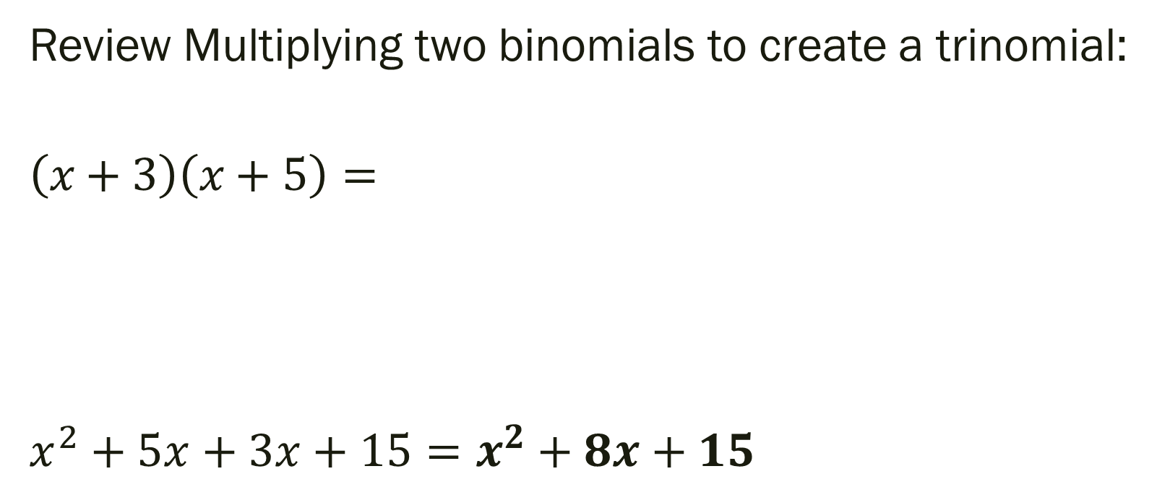
Factoring: is rewriting an expression as a product of its factors (reverse FOIL)… write a trinomial as a binomial
Review Multiplying two binomials to create a trinomial:
$$\left(x+3\right)\left(x+5\right)=$$
$$x^{2}+5x+3x+15=x^{2}+8x+15$$

Slide 8
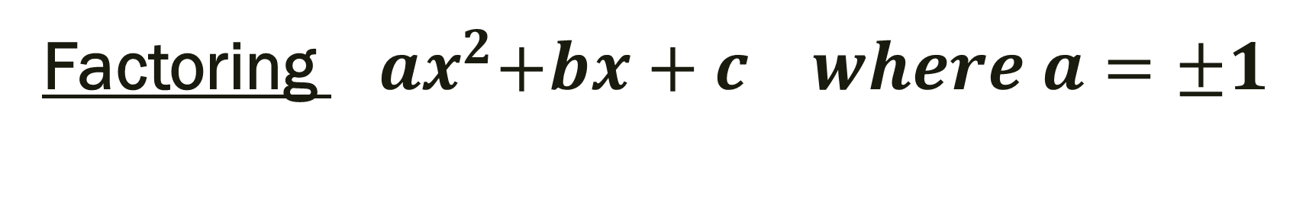
Factoring ${ ax}^{2}+bx+c where a=±1$
x² + bx + c = (x + m)(x + n) = x² + (m + n)x + m*n
b = m + n c = m*n
Steps:
1) Find 2 numbers, m and n, that multiply to give you c, and add to and get b
2) Put those numbers in the form (x + m)(x + n)

Slide 9

Factor: $x^{2}+6x+8$

Slide 10
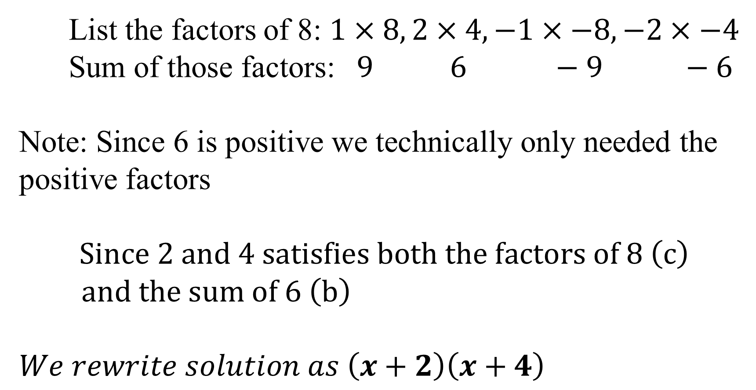
Factor: $x^{2}+6x+8$
List the factors of 8: $1×8, 2×4, −1×−8,−2×−4$
Sum of those factors: $9 6 −9 −6$
Note: Since 6 is positive we technically only needed the positive factors
$$Since 2 and 4 satisfies both the factors of 8 \left(c\right)$$
$and the sum of 6 \left(b\right)$
$$We rewrite solution as \left(x+2\right)\left(x+4\right)$$
Note: Graph original and
your answer. If they over-
lap then you know they
are the same expression

Slide 11

More Examples to Factor
$$2.) x^{2}−3x−10$$

Slide 12
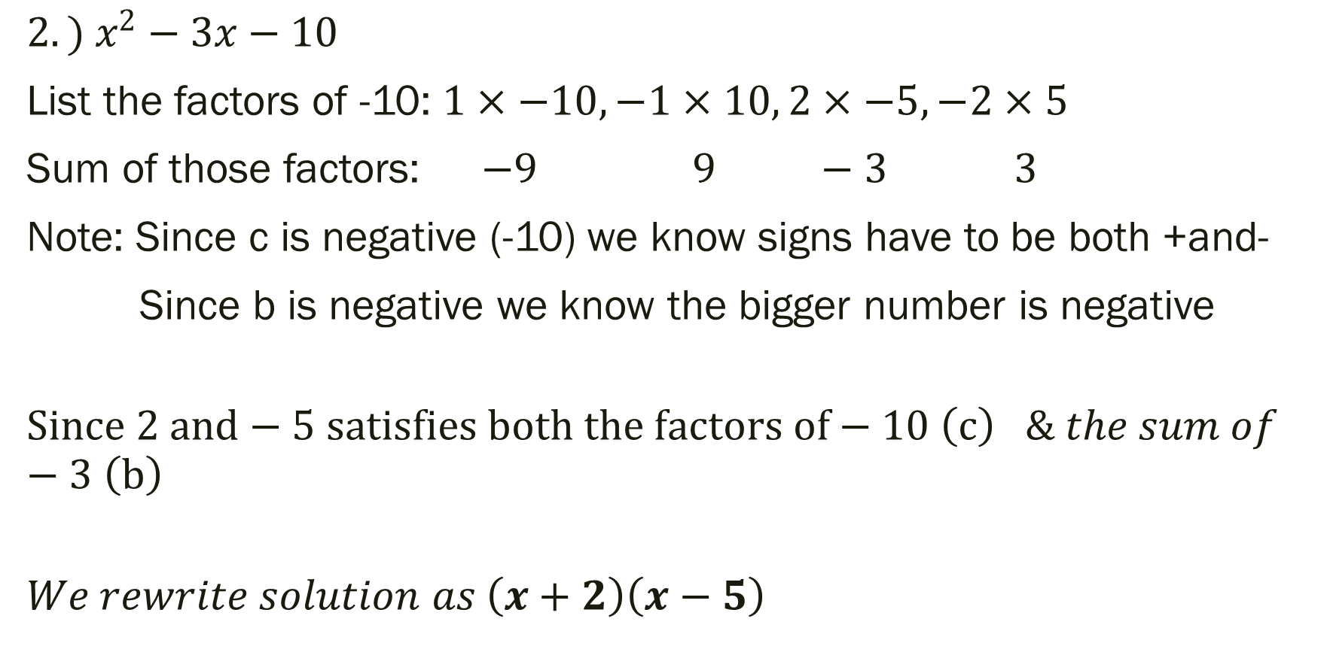
More Examples
$$2.) x^{2}−3x−10$$
List the factors of -10: $1×−10, −1×10, 2×−5,−2×5$
Sum of those factors: $−9 9 −3 3$
Note: Since c is negative (-10) we know signs have to be both +and-
Since b is negative we know the bigger number is negative
$$Since 2 and−5 satisfies both the factors of−10 \left(c\right) \& the sum of−3 \left(b\right)$$
$$We rewrite solution as \left(x+2\right)\left(x−5\right)$$

Slide 13

More Examples to Factor
$$3.) x^{2}−36$$
4.) x² – 12x – 28
5.) y² + 2y + 1
6.) q² – 19q + 90
7.) x² – 7x – 10

Slide 14
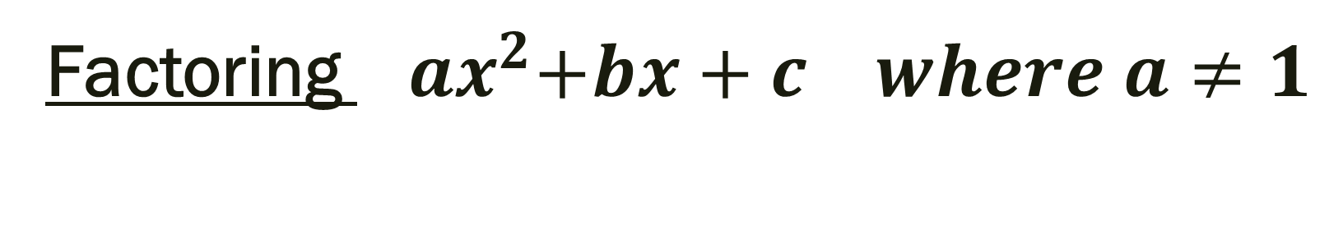
Factoring ${ ax}^{2}+bx+c where a≠1$
ax² + bx + c = (kx + m)(lx + n)= k*lx² + (k*n + l*m)x + m*n
a = k*l b = k*n + l*m c = m*n
Steps:
1)Find and list the factors of a and c
2) Set up the proportion:
3) Cross multiply to get numbers that add and
give you b. (Guess and Check)

Slide 15

Factor:
1.) $4x^{2} – 25$
2.) 2x² + x – 3
3.) 3x² – 17x + 10
4.) 8z² + 18z + 9
5.) 6x² – 9x + 5
6.) 11m² + 14m – 16
7.) $5x^{2} – 20$

Slide 16
For Next Time
New Material:
Page 221 #1–8, 15–25(odd), 33, 35,
47, 49, 51, 61, 63, 99

